Slide 1

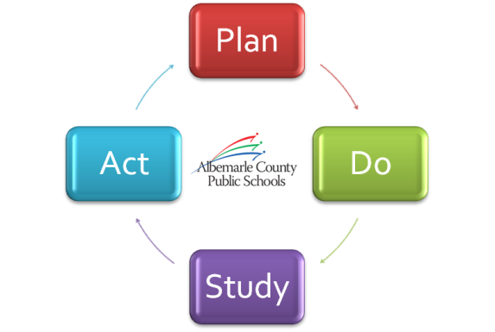
Preparing Our Students for Success
“Fine tuning our strategic plan”
June 28, 2012

Slide 2
Tonight’s Discussion
Board Priorities
KPI Refinements
Considerations for Future Board Work Sessions
Proposal for Strategic Plan Review

Slide 3
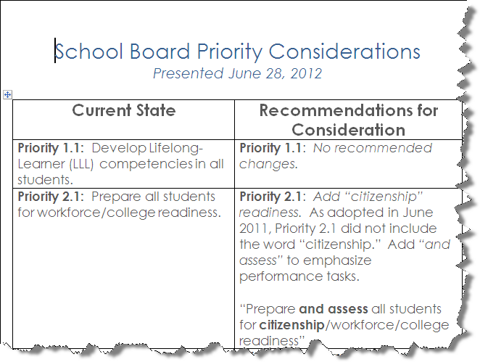
A Revisit of
Board Priority Considerations
Notes:
Link to Word document with full table of recommendations.

Slide 4
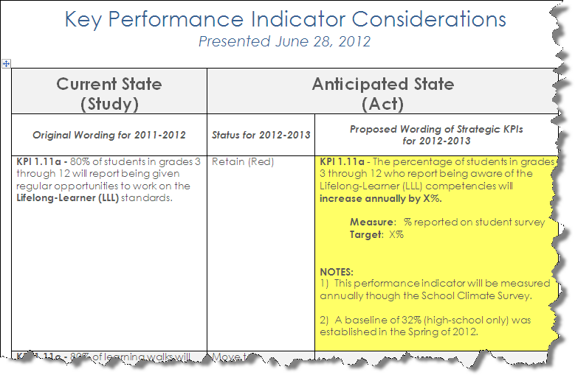
Fine-Tuning our Key Performance Indicators
Notes:
Link to Word document with full table of recommendations.

Slide 5

Taking a “Deep Dive” into
Strategic Focus Areas
2012-13 Board Work Sessions
Our Schools & Departments talk about…
Lifelong Learning
Performance Tasks
Workforce Engagement
Vision, Mission, Goals
Program Evaluation & Valuation
Academic Excellence
Learning Spaces
Continuous Improvement
Strategic Communications

Slide 6
Proposal for
Strategic Plan Review Timeline
Phase 1: Create Awareness
July - September
Phase 2: Gather Feedback from Stakeholders
October - March
Phase 3: Synthesize Feedback and Refine Strategic Plan
April - June
Notes:
Link to Word document with full table of recommendations.

Slide 7

Next Steps:
July 12th – Board Meeting
  Board direction on Strategic Plan review process
  Q4/EOY Strategic Update
Summer – Alignment
  Leadership Team notified of Board decisions
  Leaders align School & Department Improvement Plans
Summer/Fall – Implementation
  Comprehensive stakeholder review/revision of Strategic Plan

